Slide 1



AMAZON SALES ANALYSIS
View in Power BI
Last data refresh:
4/5/2024 11:29:59 AM UTC
Downloaded at:
4/15/2024 8:29:41 AM UTC

Slide 2
INTRODUCTION
This project focuses on conducting a comprehensive analysis of Amazon sales data spanning the years 2010 to 2017. The primary goal is to uncover trends, patterns, and insights within the vast dataset, shedding light on the e-commerce giant's sales performance over the specified period.

Slide 3
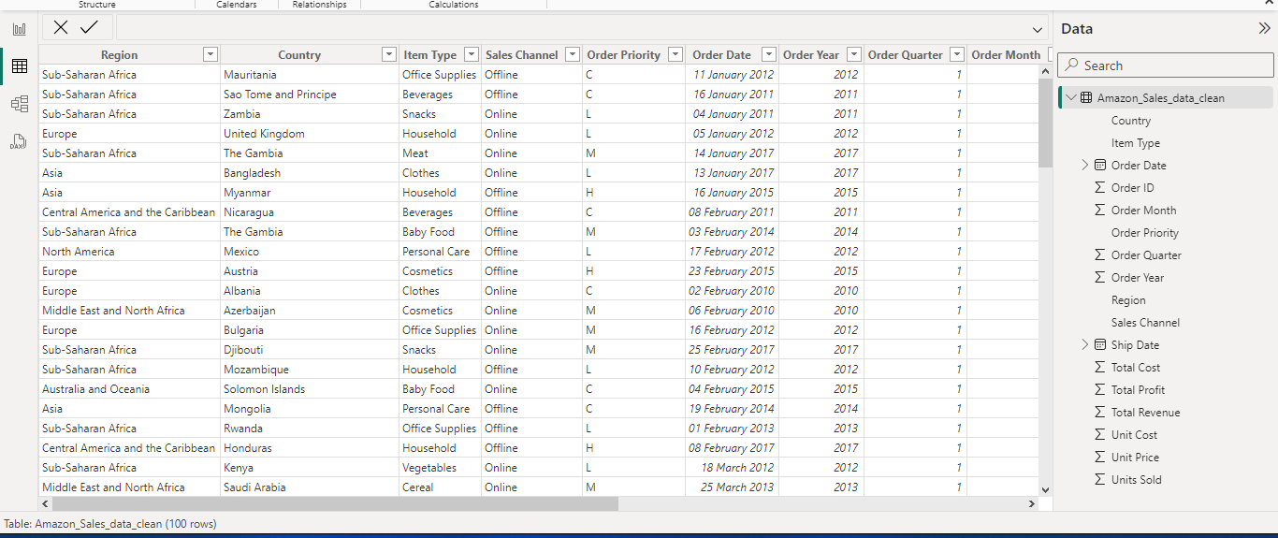
Data Collection: The dataset I used for my analysis had provided me by Unified Mentor (a remote internship provider). The dataset includes information on product (item) types, their retail prices, unit sold, unit cost, order and ship dates, geographical information, sales channels and more. Challenges in data cleaning, profiling and normalization were addressed using Microsoft Excel and Query Editor on Power BI to ensure the accuracy of the analysis.

Slide 4
METHODOLOGY
I began the Exploratory Data Analysis (EDA) phase by formulating key questions and answering them based on my understanding of the project:
What is the objective of this analysis?
The primary goal is to analyze sales, revenue, and identify patterns such as rises or falls. Additionally, the aim is to find strategies to positively impact sales and profit while reducing overall costs.
What are the topline KPIs for the business in the given data?
Key performance indicators (KPIs) include Total Revenue, Total Sell, Cost Reduction, and Profit increase over time, analyzed across different geographical locations.
What could be the determining factors influencing revenue, sales, and overall profit with the available data?
Factors considered include Customer Location, delivery time, channels of sale (offline or online), and types of order priority or urgency (Critical, High, Medium, Low).
After collecting these details and addressing related questions, I created essential measures for Power BI data visualization. This includes metrics like Total Sale, Total Revenue, Total Profit, Profit %, and others to support Time-series and Geospatial analysis.
The Time-series analysis involves examining Month-over-Month (MoM) and Year-over-Year (YoY) changes in sales to understand short-term and long-term KPI performance.
Furthermore, an examination of delivery time (ship date - order date) was conducted to comprehend its relationship with changes in sales over different regions. Recognizing the significant role of delivery time as a major contributor to customer satisfaction, it is anticipated to have a substantial influence on sales growth.

Slide 5
KEY FINDING
In the past 8 years (2010-2017), our sales experienced a significant decline, amounting to approximately $28 million. The reasons for this decline include:
A sharp drop of 66% in sales in our two major markets, Europe and Sub-Saharan Africa, occurring in 2013, followed by another substantial decrease of 76% in 2015.
Low sale is associated with regions characterized by high delivery times, exceeding 23 days on average.
Analysis of customer preferences reveals no consistent trend in the choice of product types.
Examining sales channels, offline sales are notably 17% higher than online sales. Interestingly, this trend correlates with delivery times, with offline transactions having an average delivery time of 23 days compared to 24 days for online transactions.
This data-driven analysis provides valuable insights into the challenges faced by our sales, emphasizing the impact of delivery times on overall performance. Optimization of delivery time and efficient advertising in countries with low sales (but high profit%) could be a best way forward for future sales growth.

Slide 6
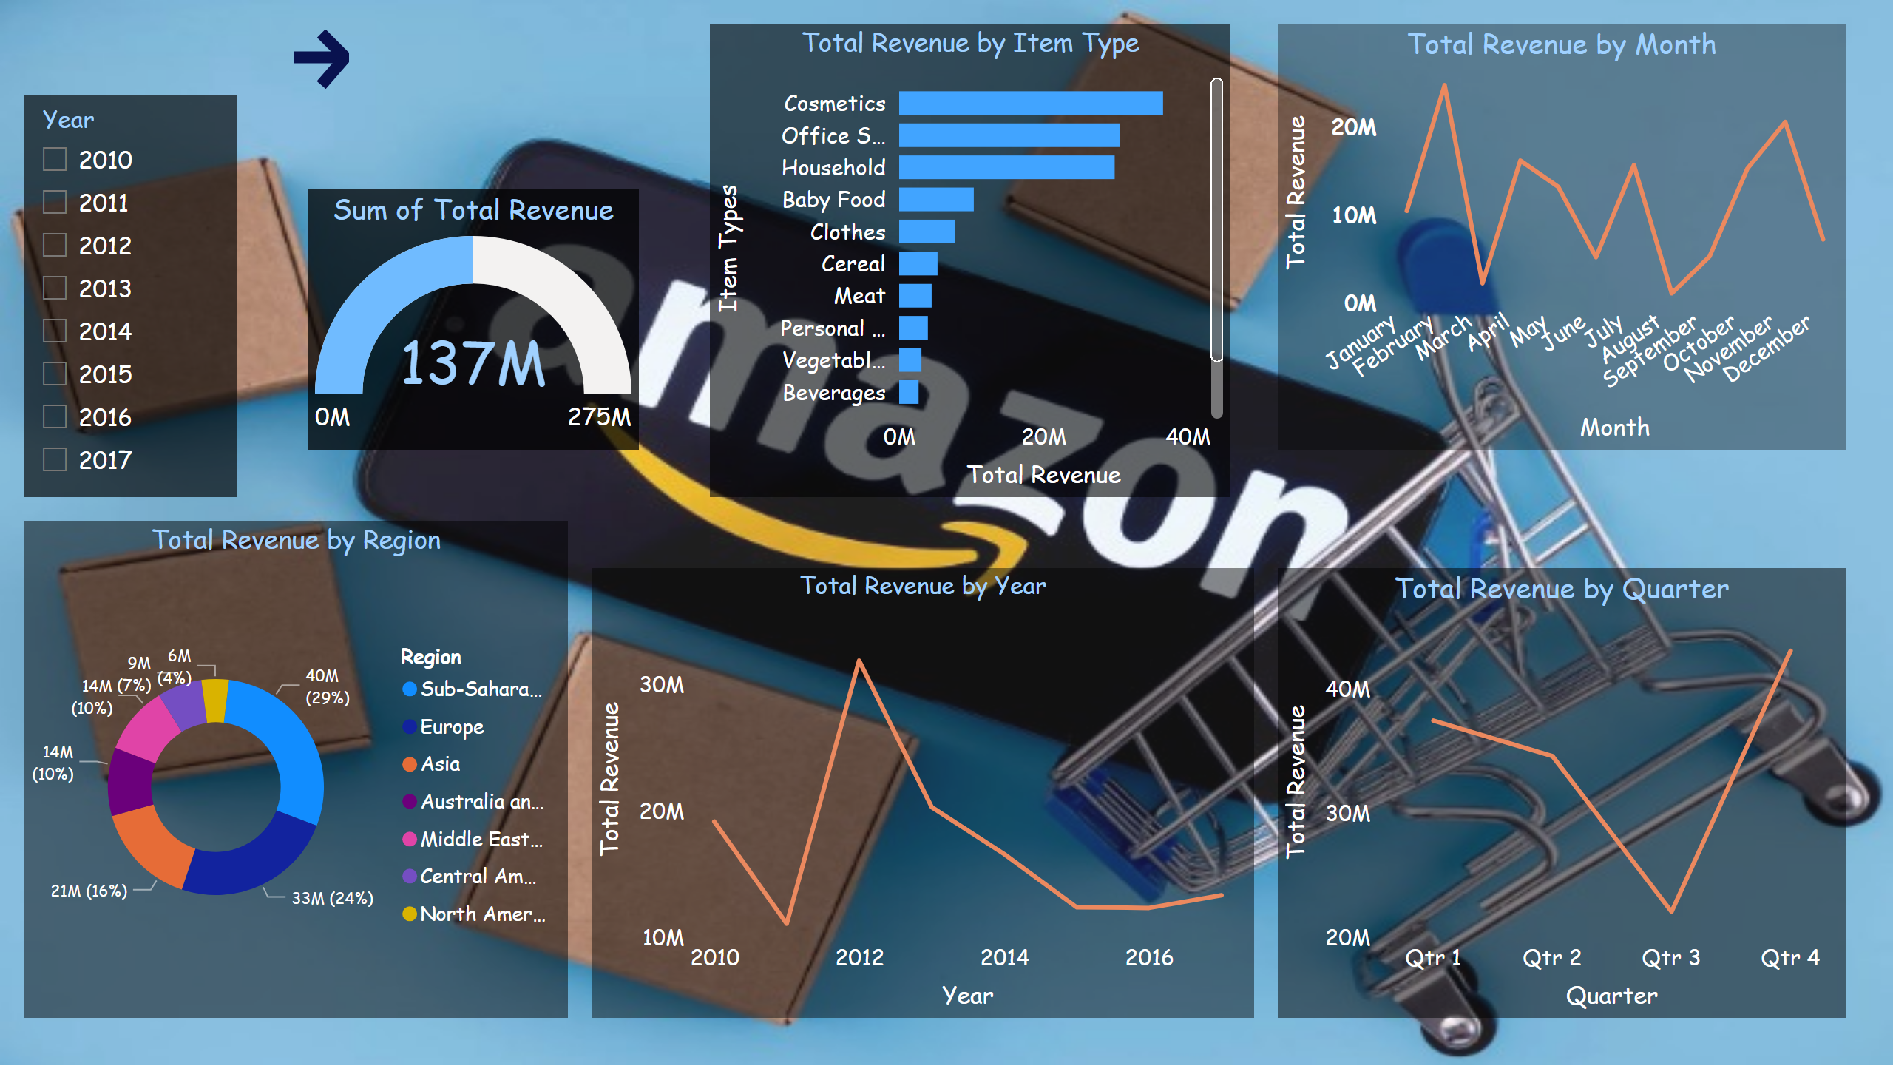
Revenue dashboard
Notes:
Total Revenue by Item Type
No alt text provided
Total Revenue by Year
No alt text provided
Total Revenue by Quarter
No alt text provided
Total Revenue by Month
No alt text provided
Total Revenue by Region
No alt text provided
gauge
No alt text provided
slicer
No alt text provided
actionButton
No alt text provided

Slide 7
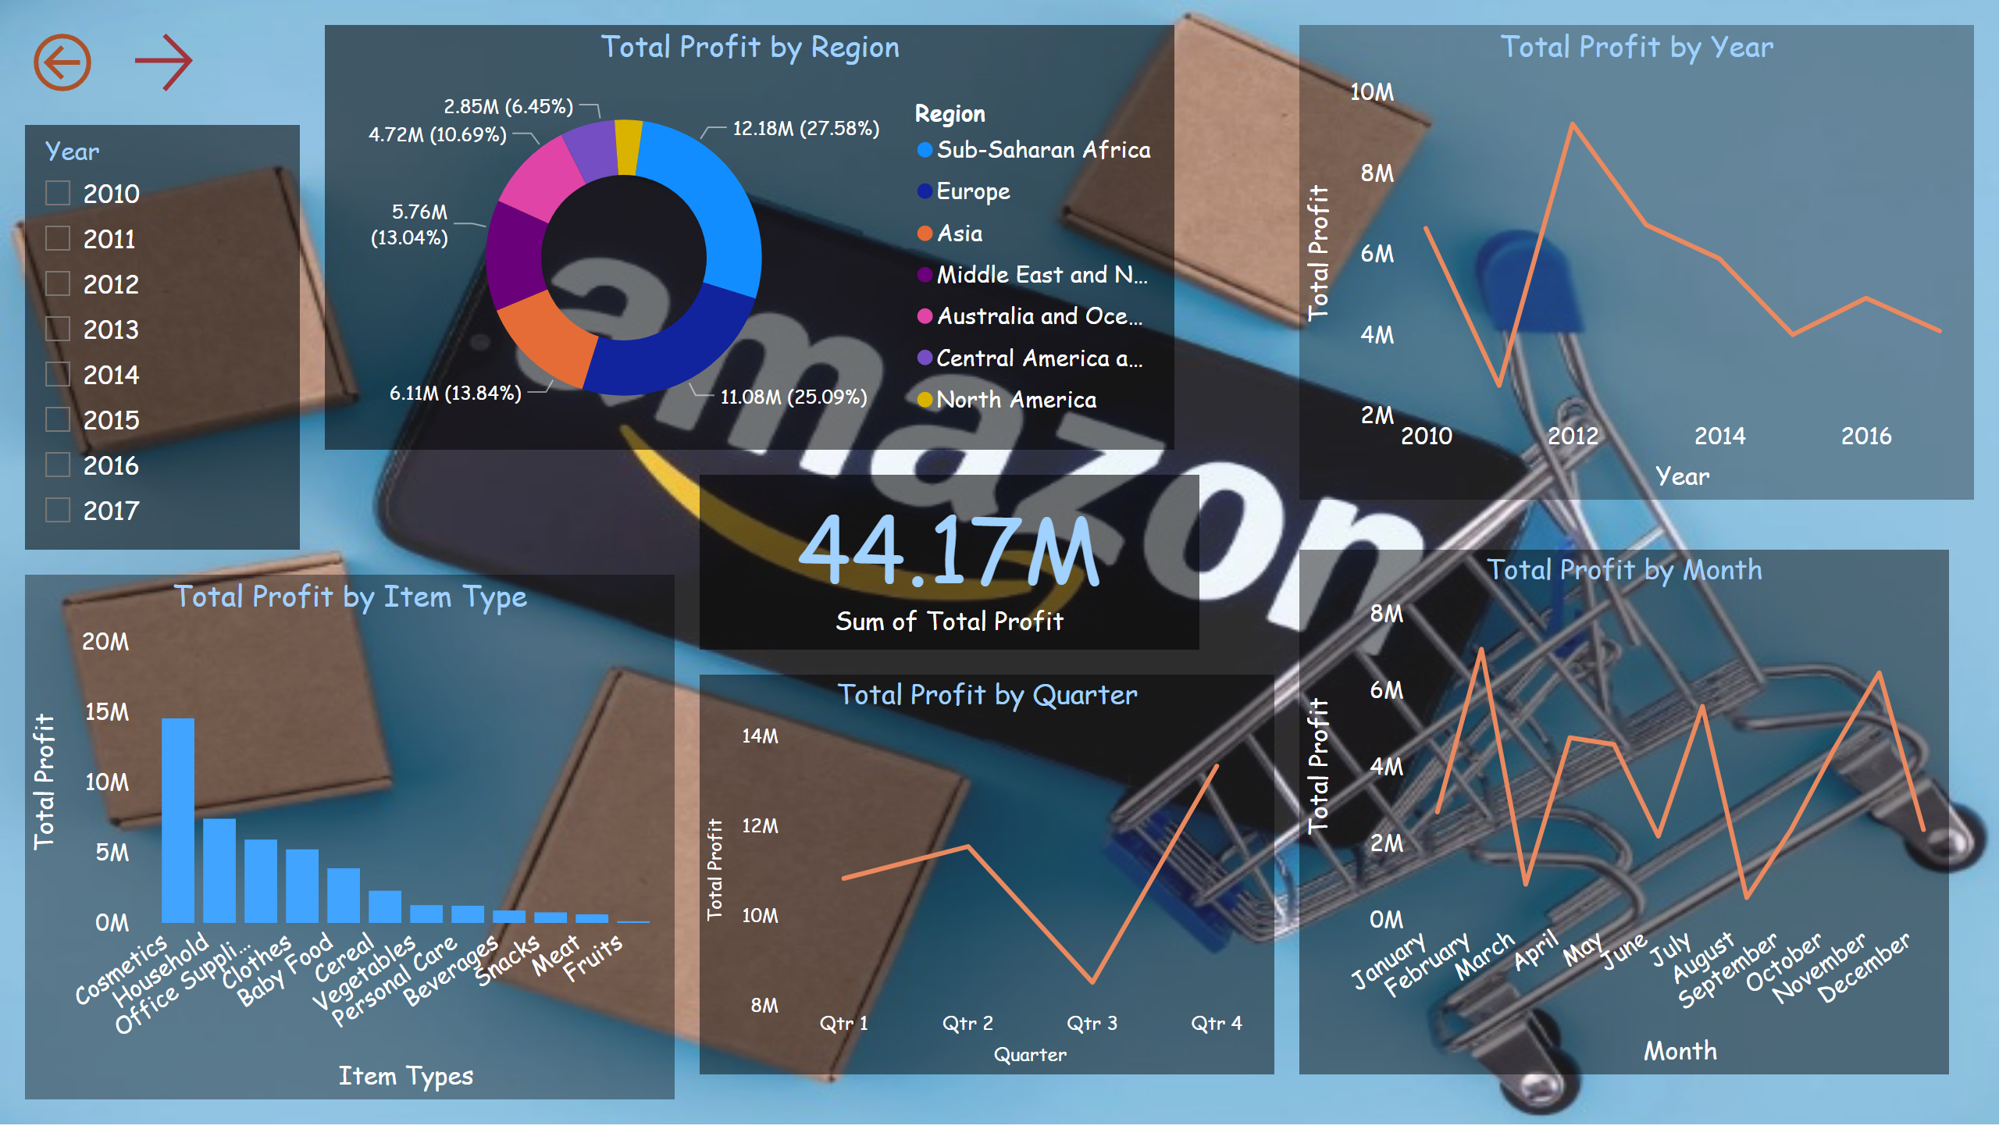
total profit dashboard
Notes:
Total Profit by Item Type
No alt text provided
Total Profit by Year
No alt text provided
Total Profit by Quarter
No alt text provided
Total Profit by Month
No alt text provided
Total Profit by Region
No alt text provided
card
No alt text provided
slicer
No alt text provided
actionButton
No alt text provided
actionButton
No alt text provided

Slide 8
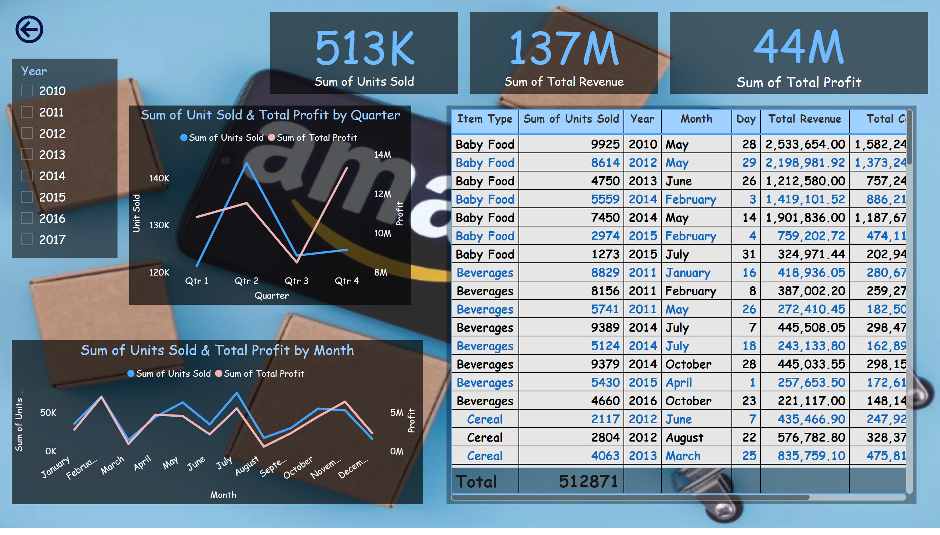
final dashboard
Notes:
card
No alt text provided
card
No alt text provided
card
No alt text provided
tableEx
No alt text provided
actionButton
No alt text provided
Sum of Unit Sold & Total Profit by Quarter
No alt text provided
Sum of Units Sold & Total Profit by Month
No alt text provided
slicer
No alt text provided

Slide 9
Implications and Significance:
The analysis indicates that for business expansion in significant markets like Asia, Amazon needs to focus on targeted advertising and reduce the current average delivery time of 27 days. Currently, Europe and Sub-Saharan Africa contribute to over 50% of total sales. Further shortening delivery times could significantly boost the business, especially considering that 53% of demands are for critical and high-priority orders.
Limitations and Future Work:
While in this analysis we tried to provide valuable insights, it is essential to acknowledge limitations such as the scope of the available dataset and potential biases from my side. So, my future work could involve exploring more granular data, incorporating real-time updates and statistical methods and considering external factors such as economic conditions that may impact Amazon's sales dynamics.
Conclusion:
In this project, I aimed to unveil hidden patterns within Amazon's E-commerce business goals and objectives, by utilizing my newly acquired skills in Excel and Power BI.

Slide 10
THANK YOU

